Slide 1

KALERWE
S.D.A Hymnal 186
4 ~ Verses
49.
Nzudde Ow’Omukwano…
~
I’ve Found a Friend…

Slide 2

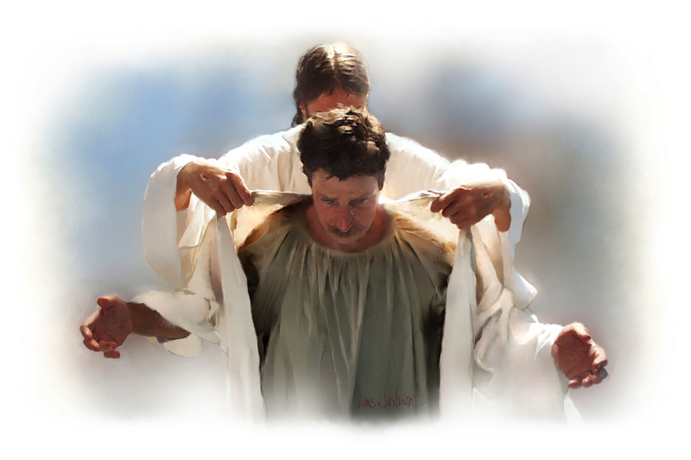

1 of 4 verses
Nzuddeyo ow’omukwano,
Yasook(a) okwagala nze.
N’ampalula mu- kisa kye,
Ekyakkirizisa nze.
Leero ndi muddu we,
Naye Abaddu be ba ddembe;
Nze wuwe, na-ye wange,
(E)mirembe n’emirembe.

Slide 3
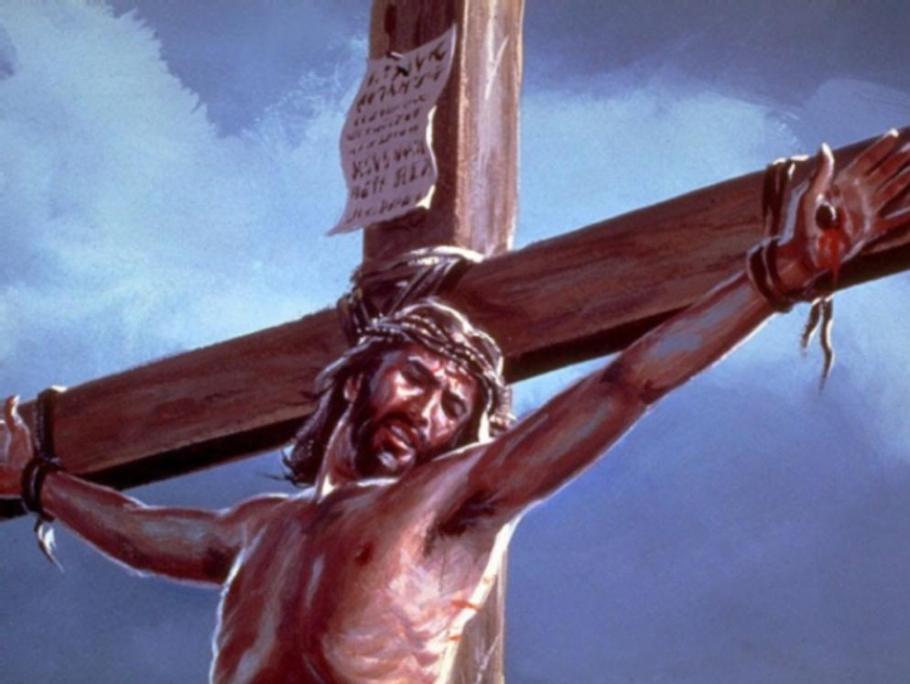
2 of 4 verses
Nzuddeyo ow’omukwano Yaff(a) okundokola nze,
Kubanga obu-lamu bwe
Ye bwe yagabira nze;
Nze sirina obugagga.
Ebyange bibye byonna;
Newaayo mu mi-kono gye
Mukwano gwange ddala.

Slide 4
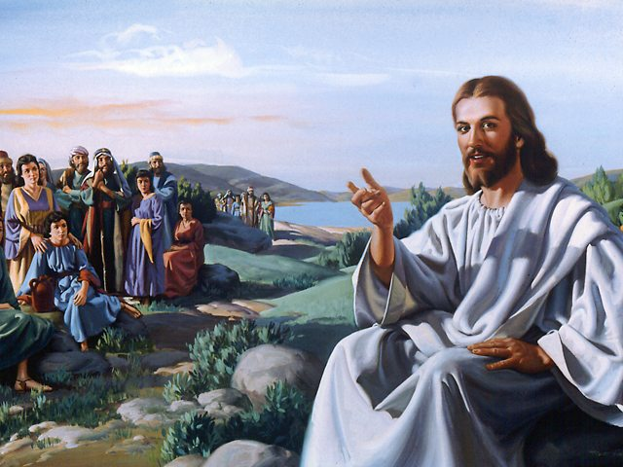
3 of 4 verses
Nzuddeyo ow’omukwano
Yaweebwa (a)maanyi gonna
Ge galintusa ewuwe;
Sitya balabe bonna.
Eby’egulu mbirengera
Bimyansa nnyo ng(a) efeza:
Kale nkole, nfu-be, nwane!
Alidd(a) Okumpummuza

Slide 5
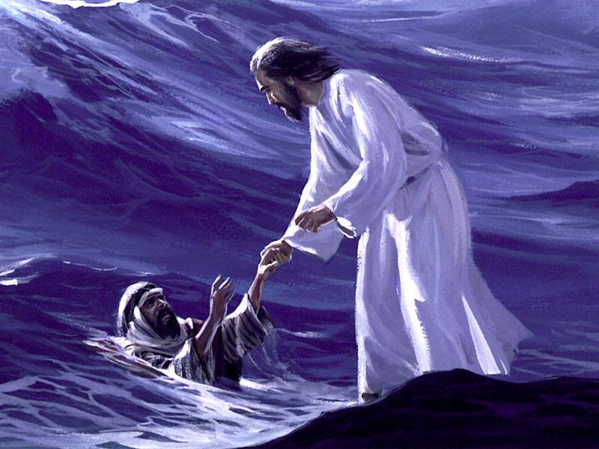
4 of 4 verses
Nzuddeyo ow’omukwano
Mulungi. ow’ekisa;
Angabira ku- maanyi ge,
Annu’ngamy(a) er(a)
andiisa.
Ebiriwo n’ebirijja
Tebirinjawukanya;
(E)mirembe egitaggwawo
Yesu mukwano gwange.

